Slide 1
Aoka’s Food Shop A E-commerce website

Slide 2
Abstract
We are going to make a web application and android application for Aoka’s Food Shop. It is e-commerce project, in which the website and application will show the items of the shop and the customers can shop online through it very simply. We desire to make their wish true cost effectively as independent online shopping mode other than the giant companies like amazon, bigbasket and alike.

Slide 3
Problem Summary
Pandemic Situation
In situations like covid we cannot go outside.
It is risky, so the customers needed an alternative to shop.
Exceeding Stock
As people stayed home, items were not reselling.
It means, the company is in loss and can even closedown if that continues.
Limited Profit and Growth
In 21st century there is way too much competition.
For growth, company needs to give their customer exotic services like going online.

Slide 4
Project Purpose
A customer orders through the app successfully, shares the app to others as it is free application.
We make more profit as we have customers online and offline, and we can give exposure to this small shop through it.
The main purpose was to grow the business of Aoka’s shop and as we can see above, we have made it possible.

Slide 5
Project Scope
Limited Scope
We will serve the particular area in which the shop is.(15-20 miles)
Expanded Scope
As Internet users increase day by day, scope of success increases.

Slide 6
Hardware Requirements
Client Side(Pc)
Client Side(Mobile)
Server Side
2 core processor, 1.6 GHz or higher
Android 7 or above
2 core processor, 1.6 GHz or higher
2 GB RAM
4 GB RAM
500 MB free space is recommended
100 GB HDD Storage

Slide 7
Technology Used
Operating System
Frontend
Backend
Programming Tools
Documentation Tools
Windows 10
HTML
PHP
Notepad++
Microsoft Word
CSS
MySQL
Android Studio
Microsoft PowerPoint
JavaScript
Android

Slide 8
Functional Requirements
User action on the website.
Admin console for management of content, products and data.
Display items.
Add to cart, confirmation to buy and order fulfilment.
User checkout and payment.
It will be mobile-friendly.

Slide 9
Non-Functional Requirements
Show Best-Selling items.
Show each and every category of items.
Security.
Speed of web services.
Sorting items.

Slide 10
Constraints
High cost of technology, that is managing servers.
Fear of ordering online.
Spamming of unnecessary bots, to spread problems.
Product Sustainability until it is delivered.
Privacy of customer, as he has entered his details for shopping.

Slide 11
Assumptions and Dependencies
Assumptions
We will assume that the customer knows how to use browser.
The servers and database will work properly.
The admin cannot shop with his id, he can just change things.
The customers will only order responsibly.
Dependencies
We have embedded map, so we depend on google maps.
Our fonts are being used from google.
Online payment is dependent on the bank.

Slide 12


Technology and Literature Review
HTML stands for HyperText Markup Language. It is used to design web pages using a markup language. HTML is the combination of Hypertext and Markup language. A markup language is used to define the text document within tag which defines the structure of web pages.
CSS(Cascading Style Sheets) is the language for describing the presentation of Web pages, including colors, layout, and fonts. It allows one to adapt the presentation to different types of devices, such as large screens, small screens, or printers.

Slide 13


Technology and Literature Review
The term PHP is an acronym for PHP: Hypertext Preprocessor. PHP is a server-side scripting language designed specifically for web development. It is open-source which means it is free to download and use. It is very simple to learn and use.
Android is an open source and Linux-based operating system for mobile devices such as smartphones and tablet computers. Android was developed by the Open Handset Alliance, led by Google, and other companies.

Slide 14
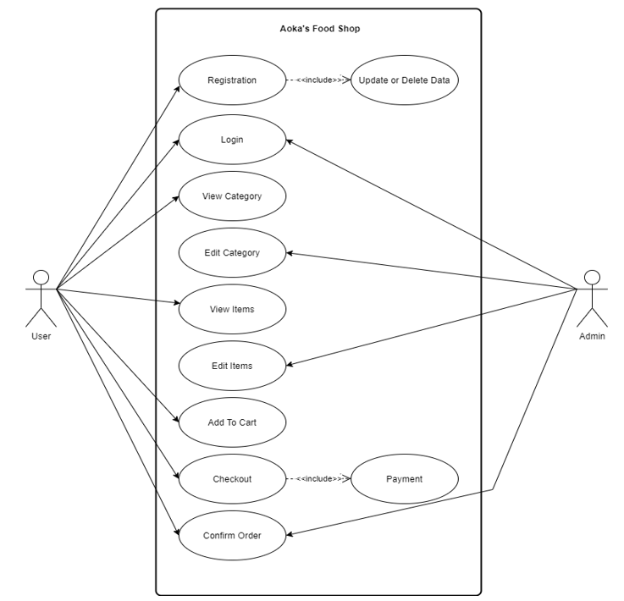
USECASE DIAGRAM

Slide 15
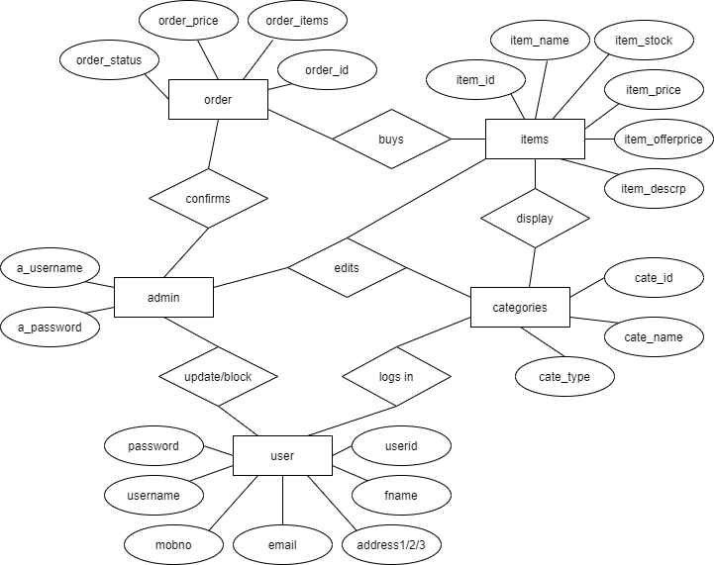
ER DIAGRAM

Slide 16
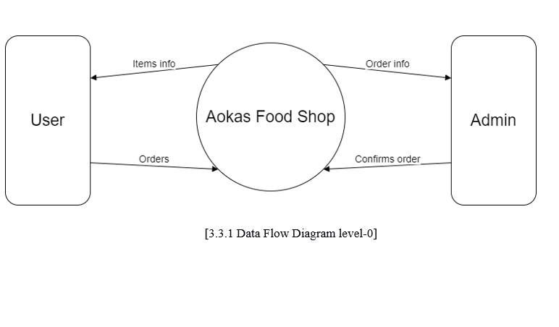
DATA FLOW DIAGRAM LEVEL-0

Slide 17
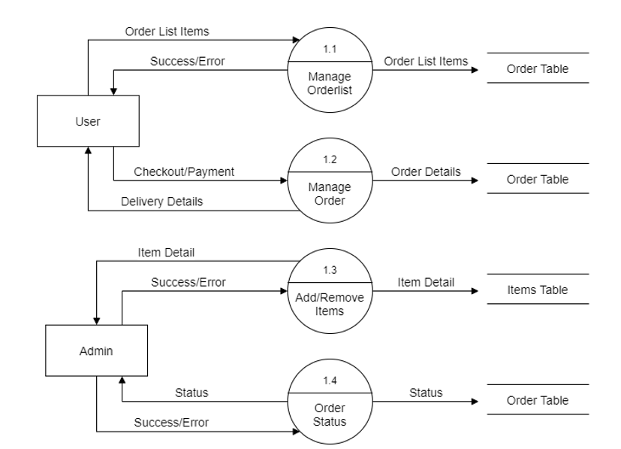
DATA FLOW DIAGRAM LEVEL-1

Slide 18
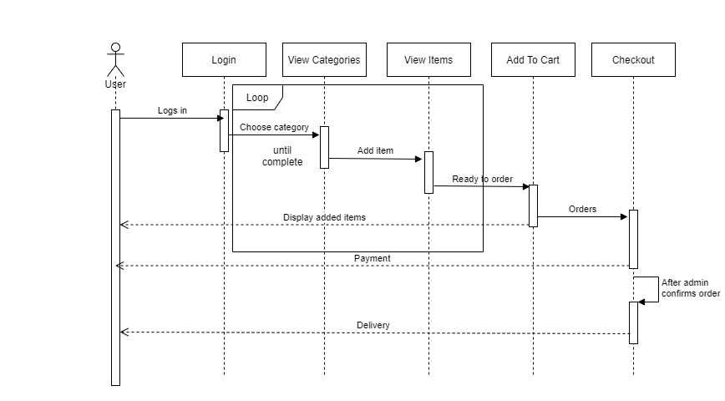
SEQUENCE DIAGRAM

Slide 19
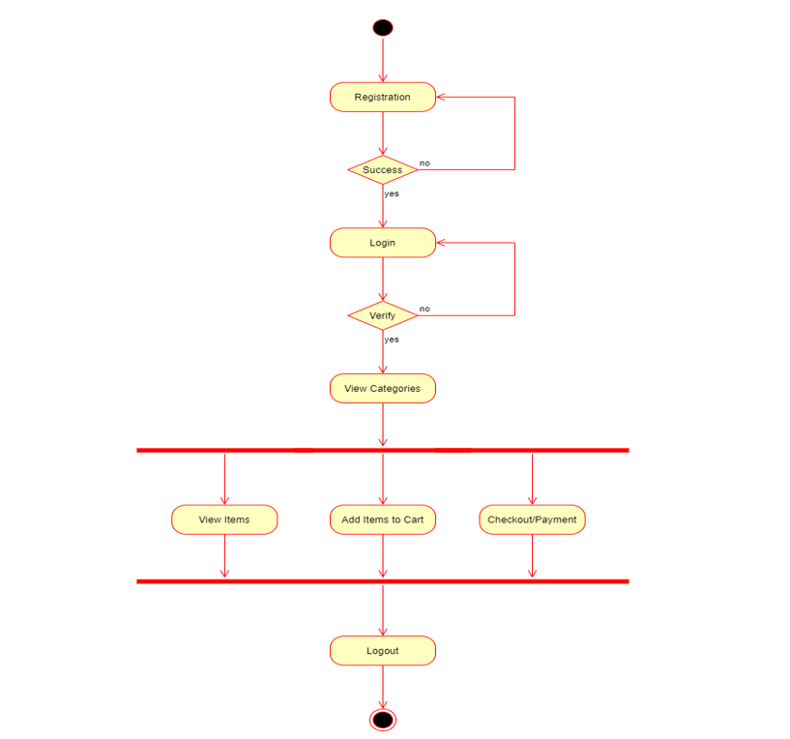
ACTIVITY DIAGRAM FOR USER

Slide 20
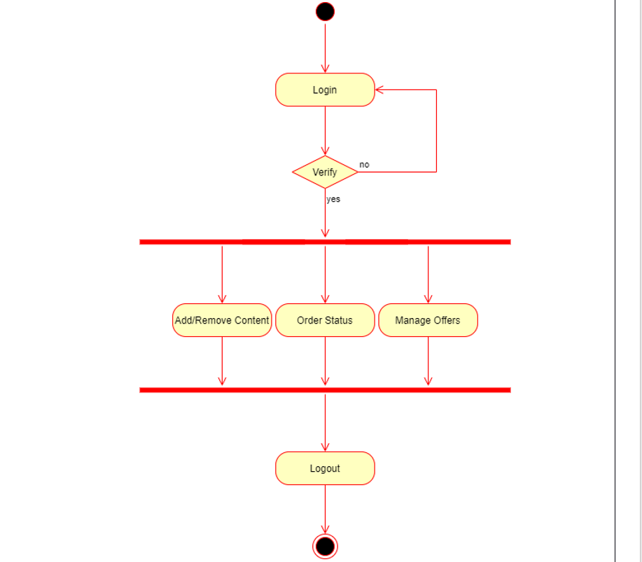
ACTIVITY DIAGRAM FOR ADMIN

Slide 21
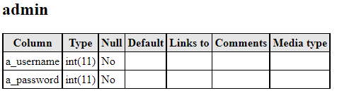
DATA DICTIONARY : admin

Slide 22
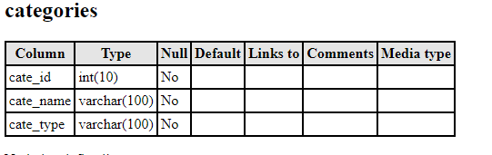
DATA DICTIONARY : categories

Slide 23
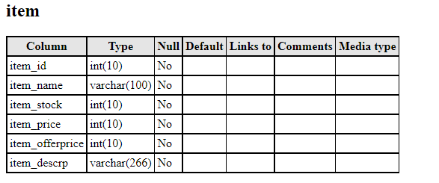
DATA DICTIONARY : item

Slide 24
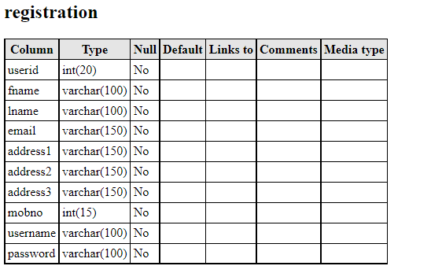
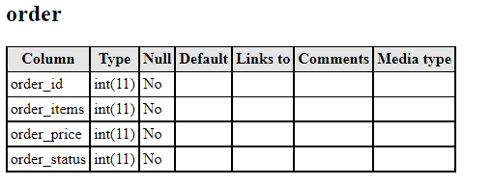
DATA DICTIONARY : registration

Slide 25
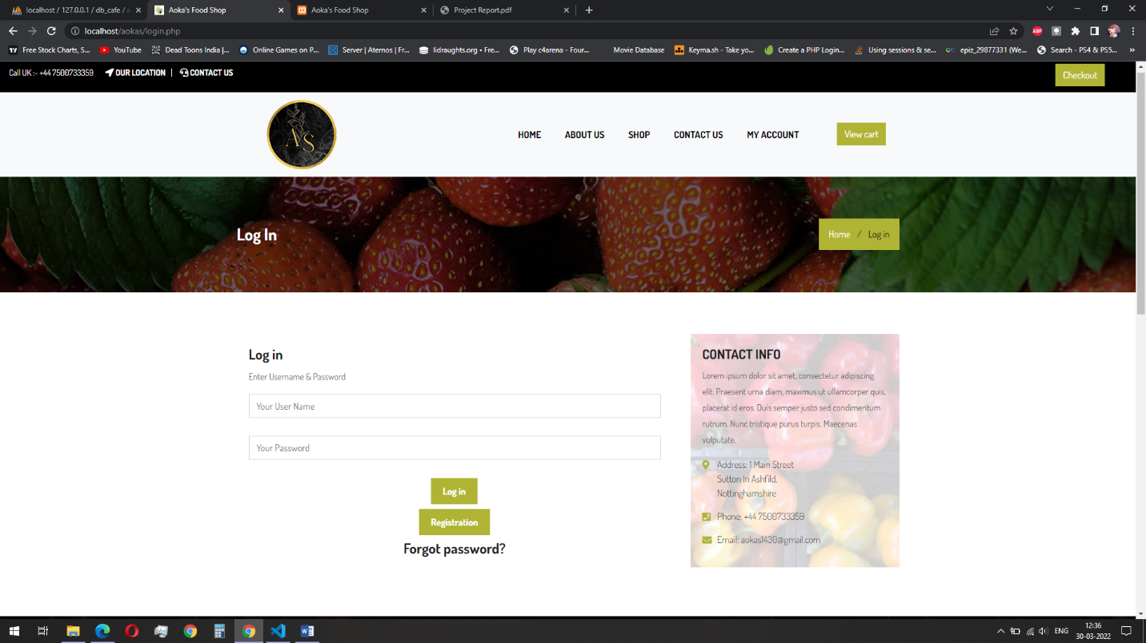
SNAP SHOT : login page for user

Slide 26
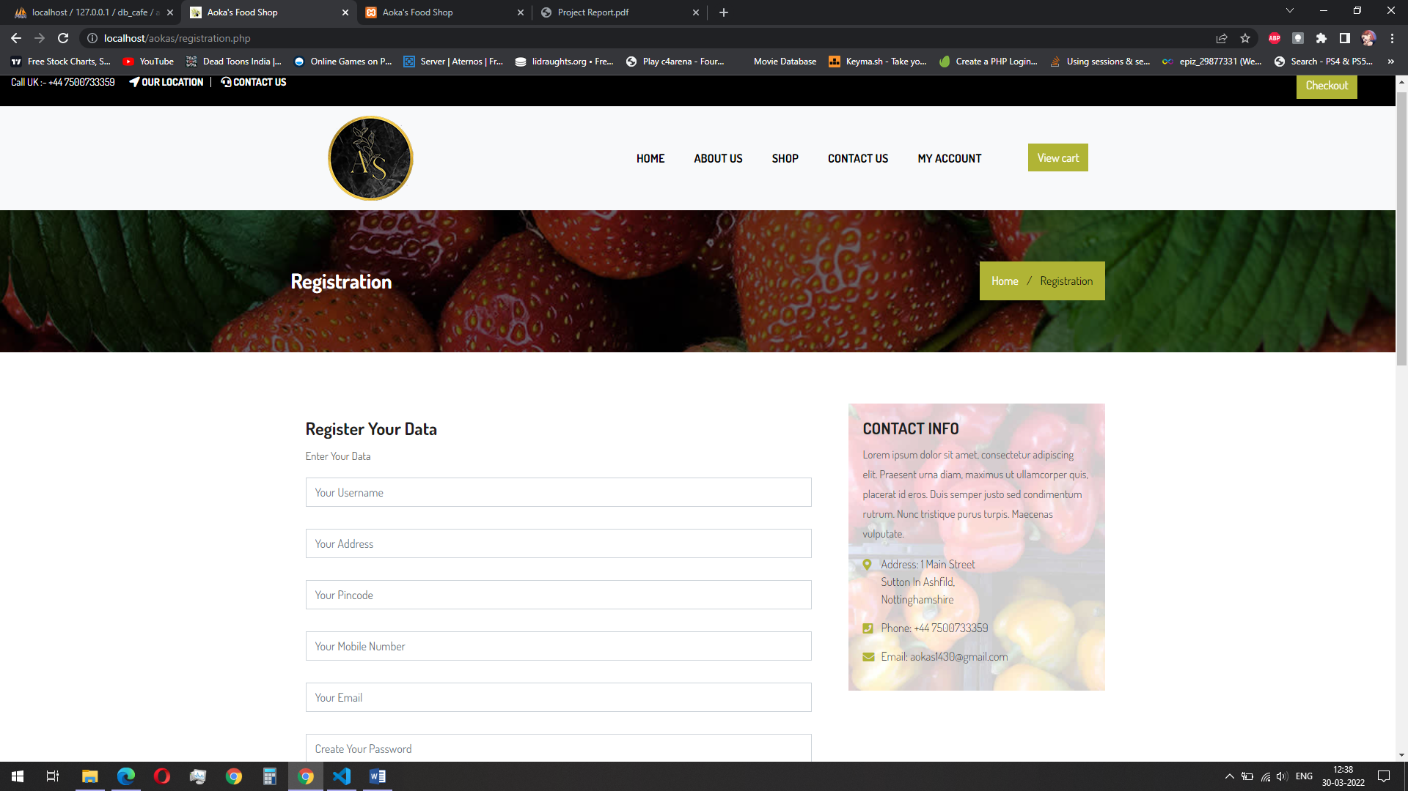
SNAP SHOT : registration for user

Slide 27
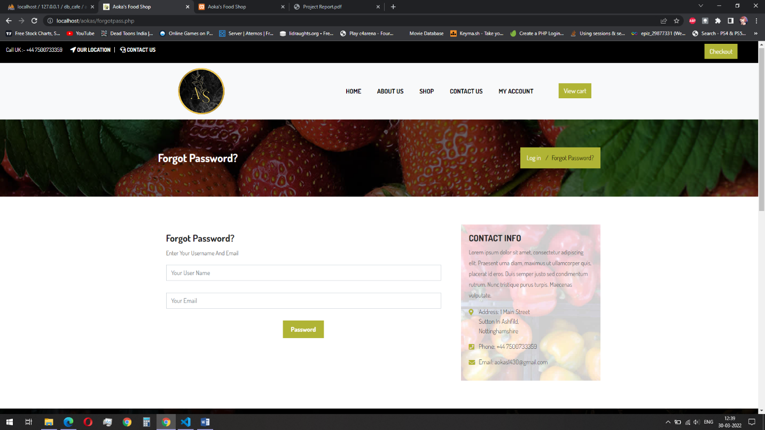
SNAP SHOT : forgot password for user

Slide 28
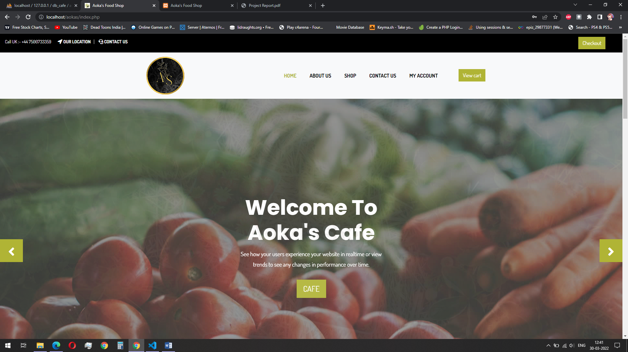
SNAP SHOT : home page for user

Slide 29
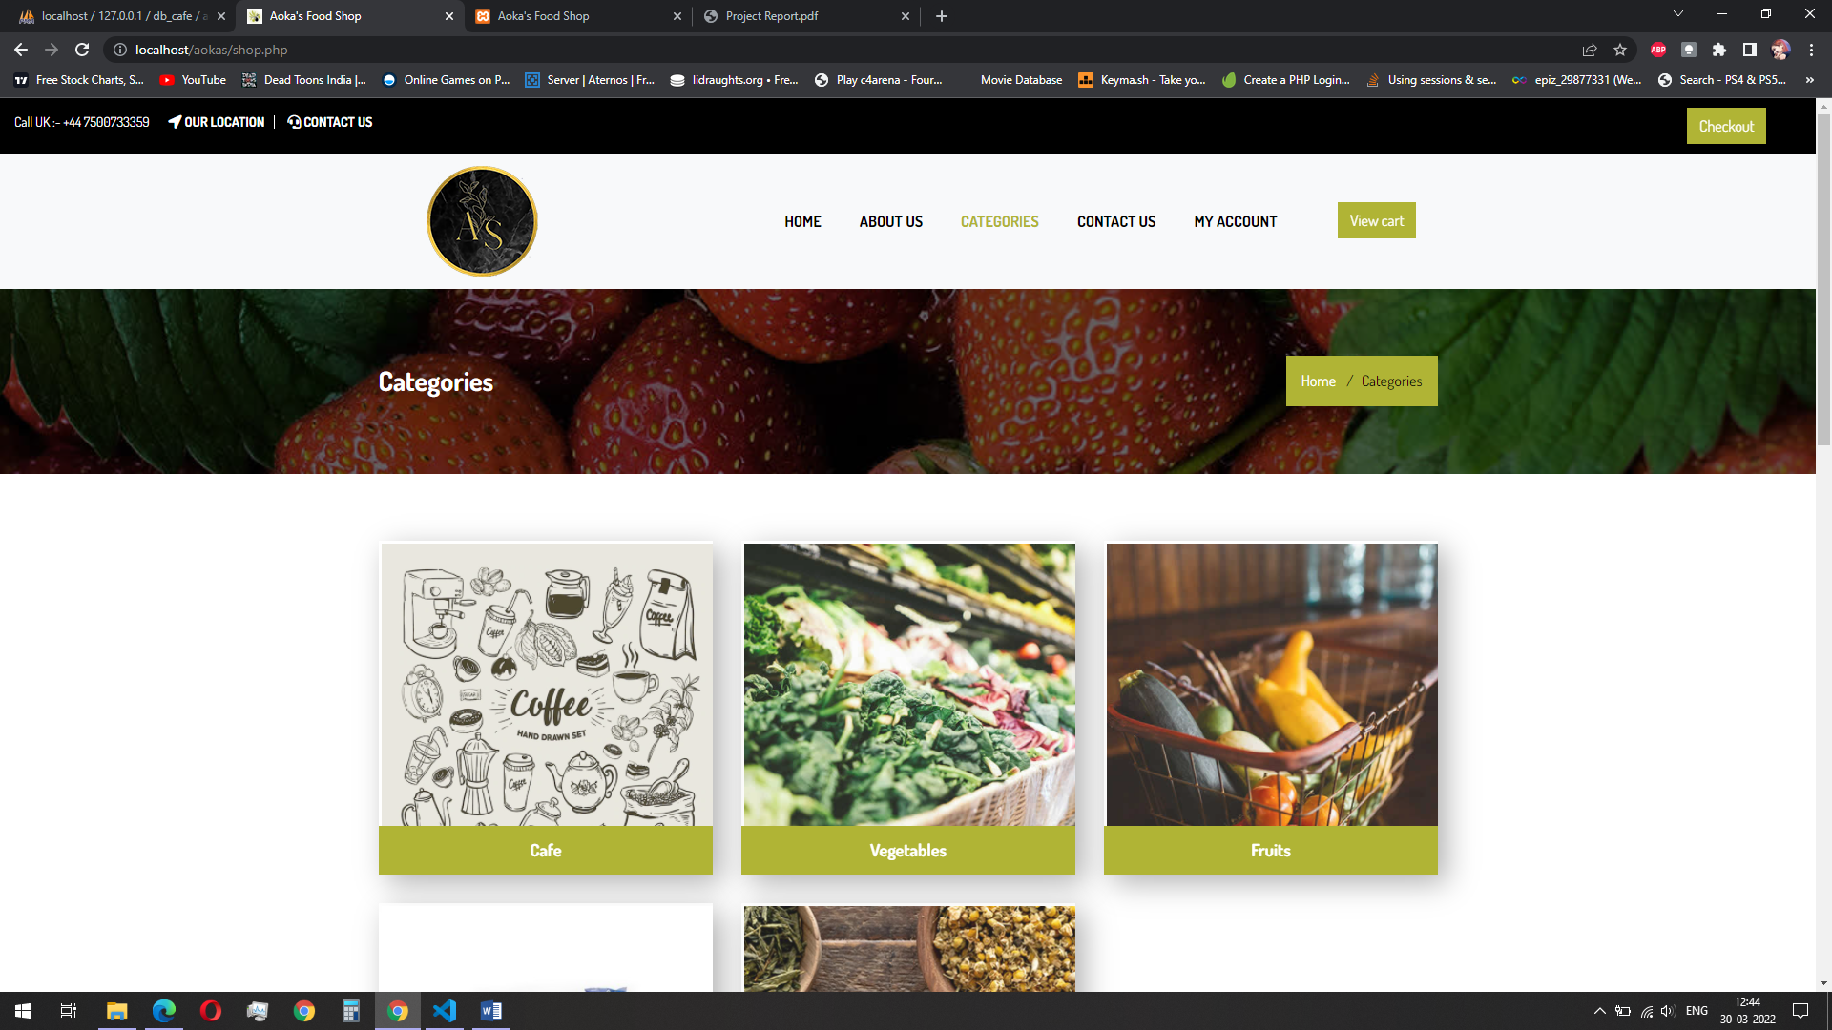
SNAP SHOT : categories for users

Slide 30
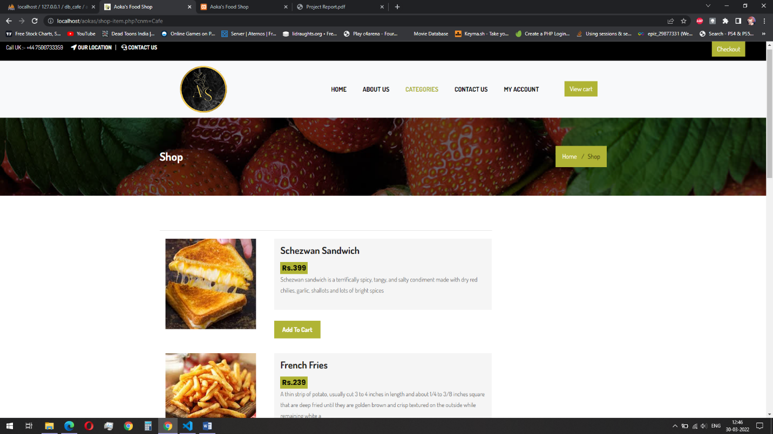
SNAP SHOT : items for user

Slide 31
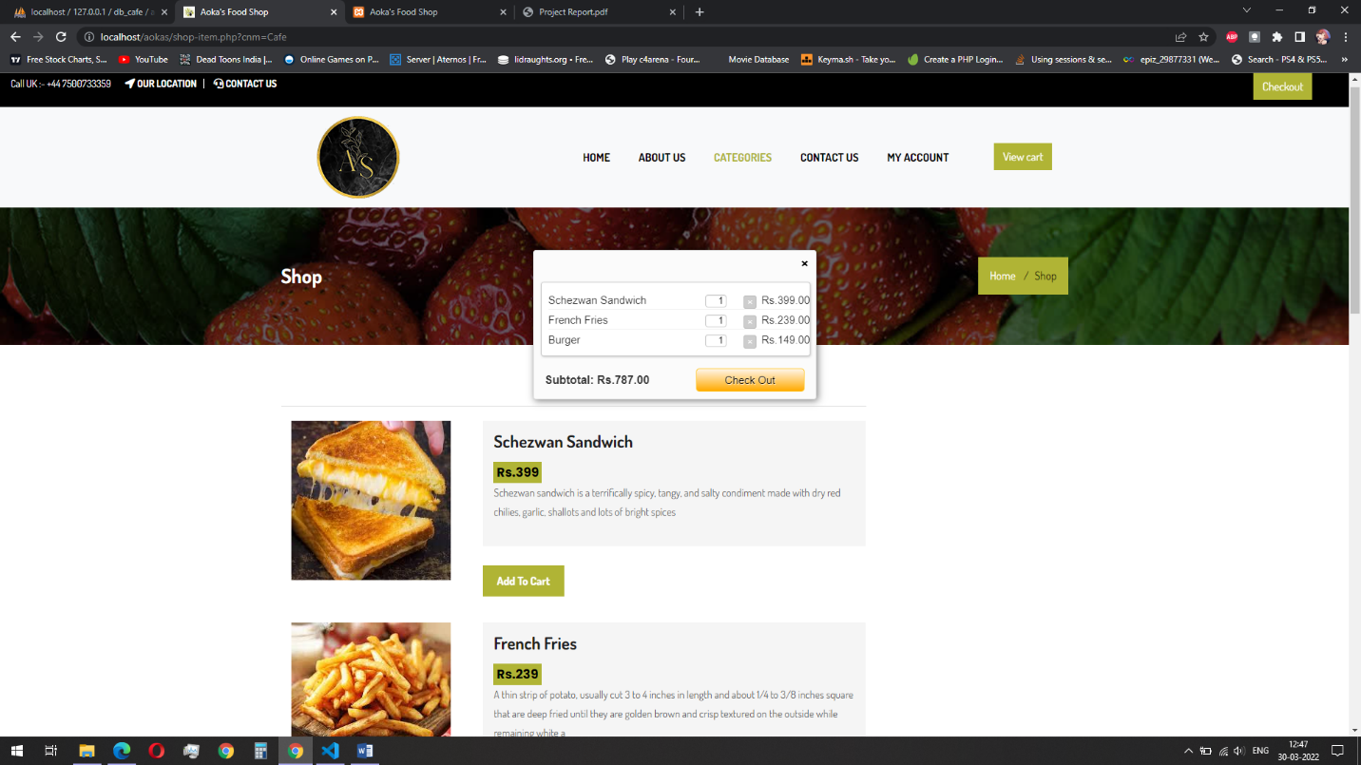
SNAP SHOT : cart for user

Slide 32
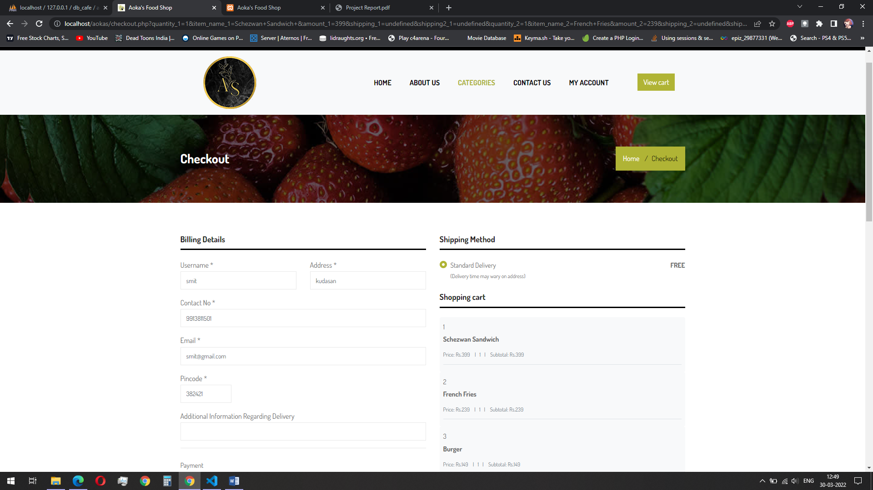
SNAP SHOT : check out for user

Slide 33
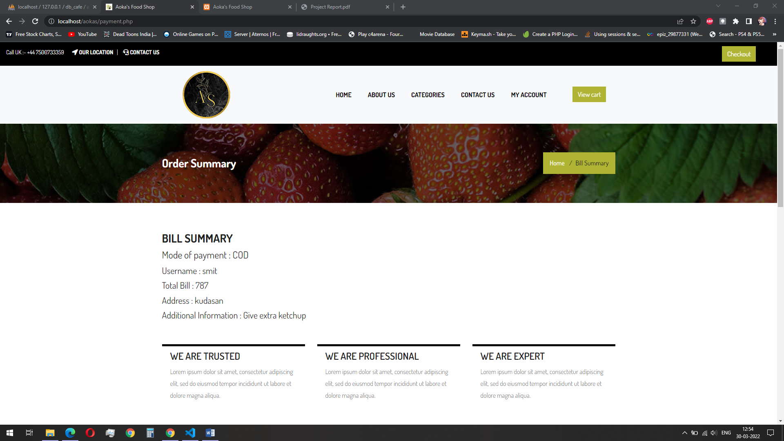
SNAP SHOT : bill summary for user

Slide 34
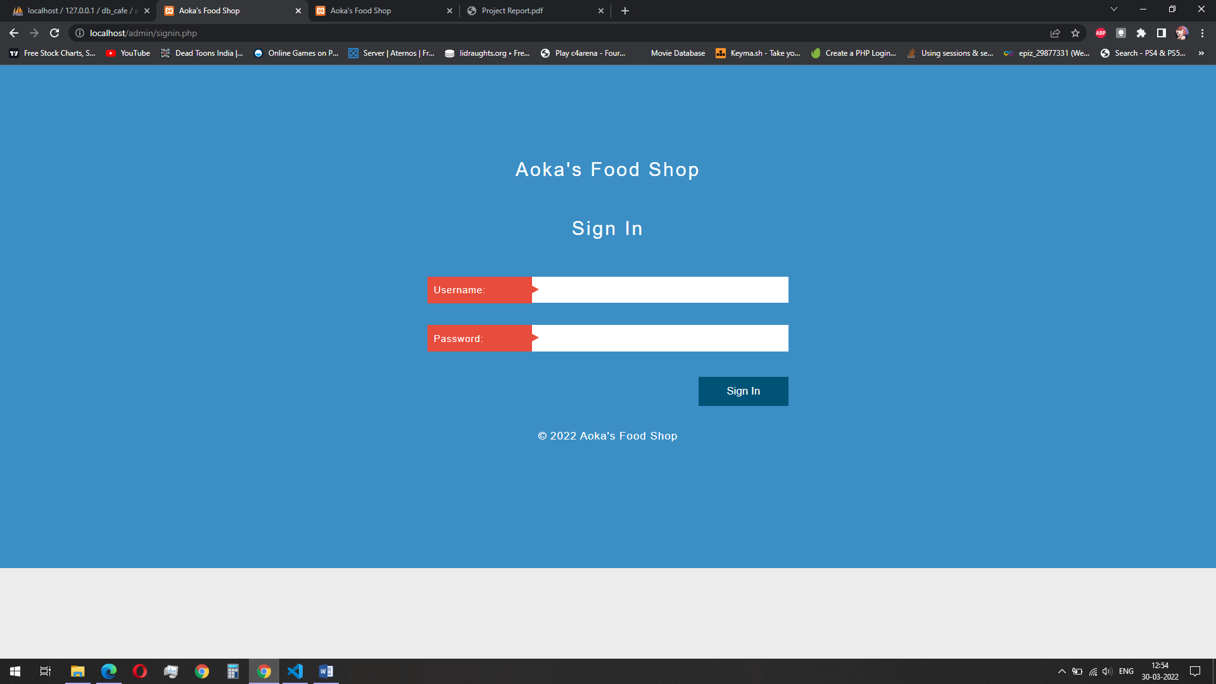
SNAP SHOT : login for admin

Slide 35
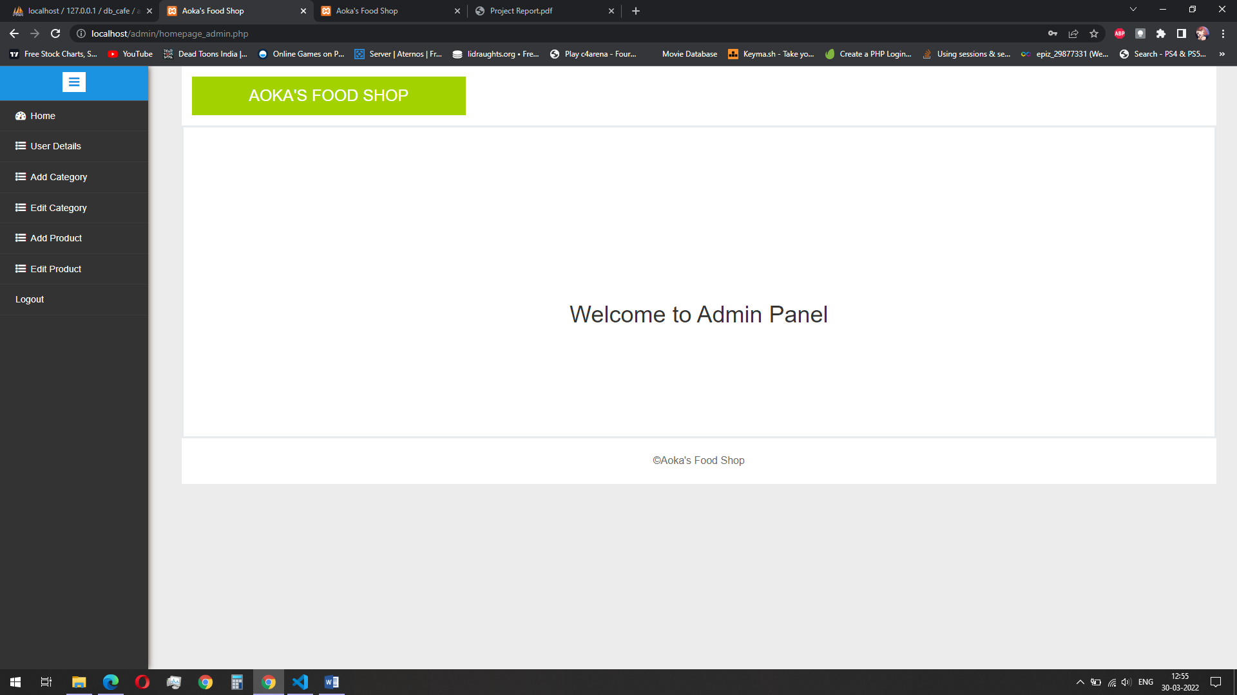
SNAP SHOT : homepage for admin

Slide 36
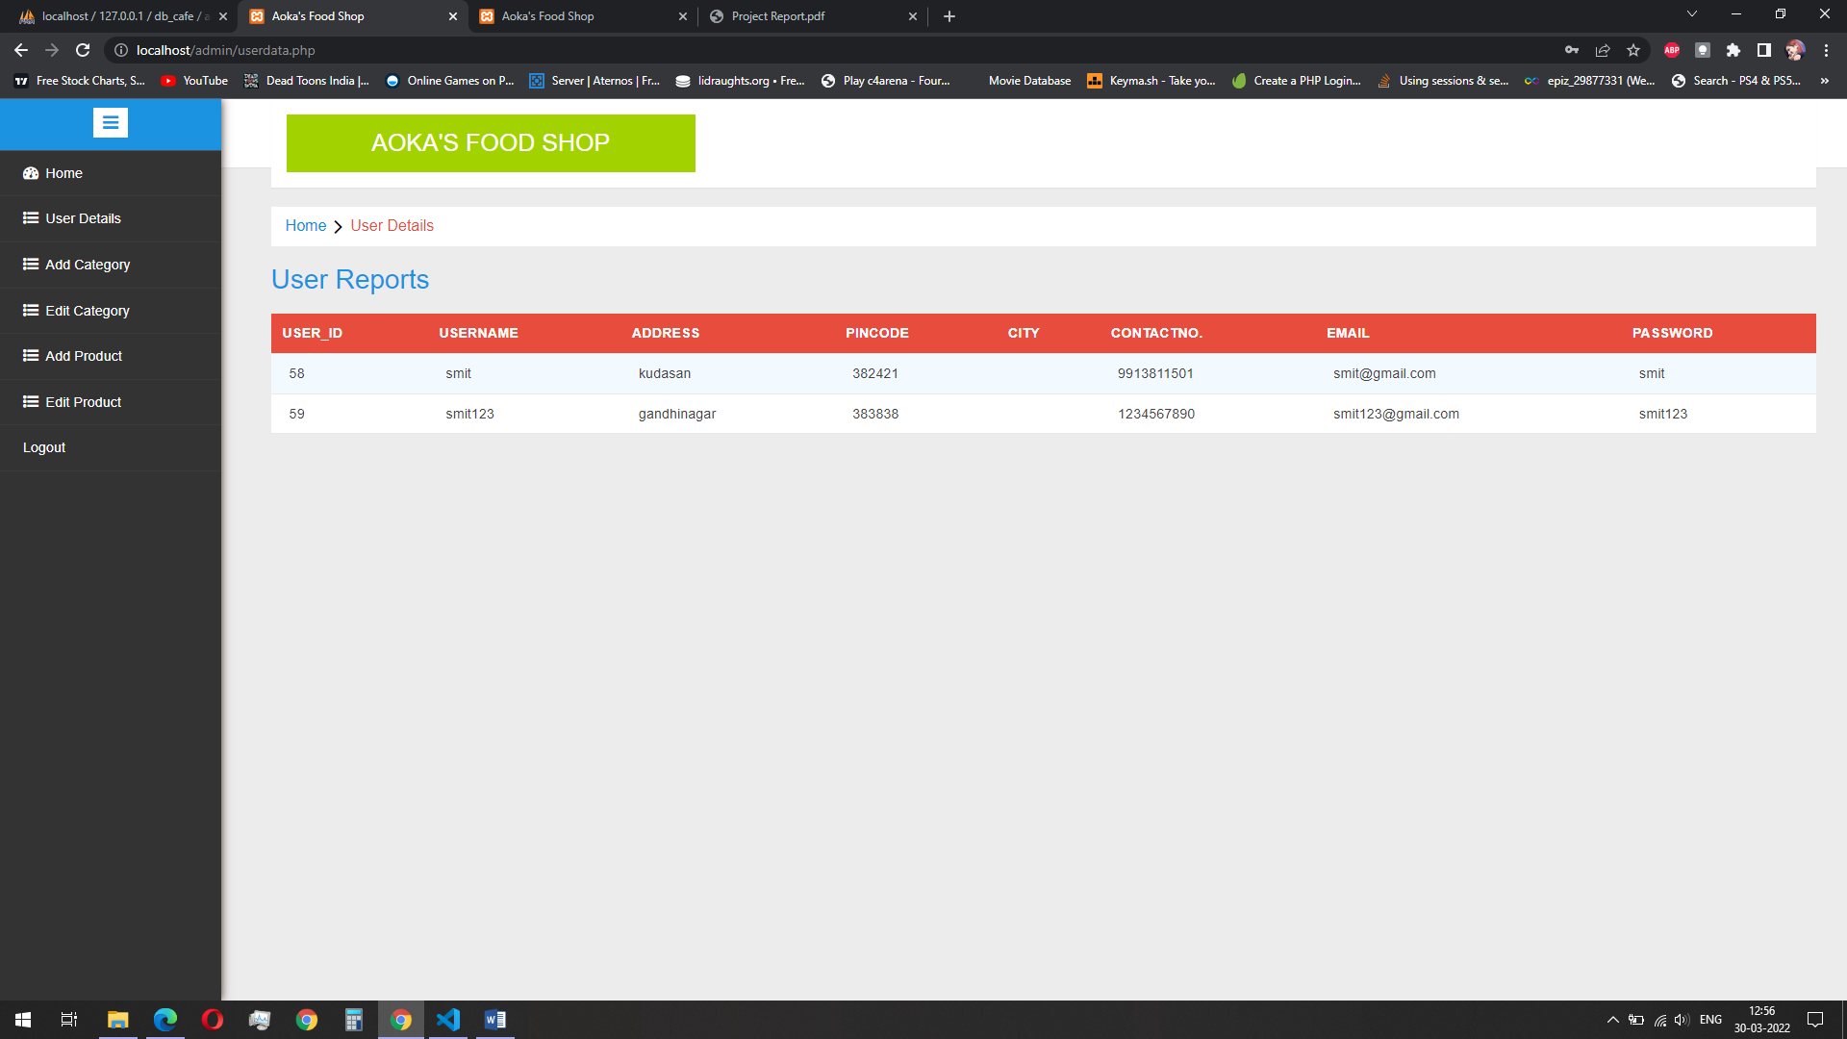
SNAP SHOT: user details for admin

Slide 37
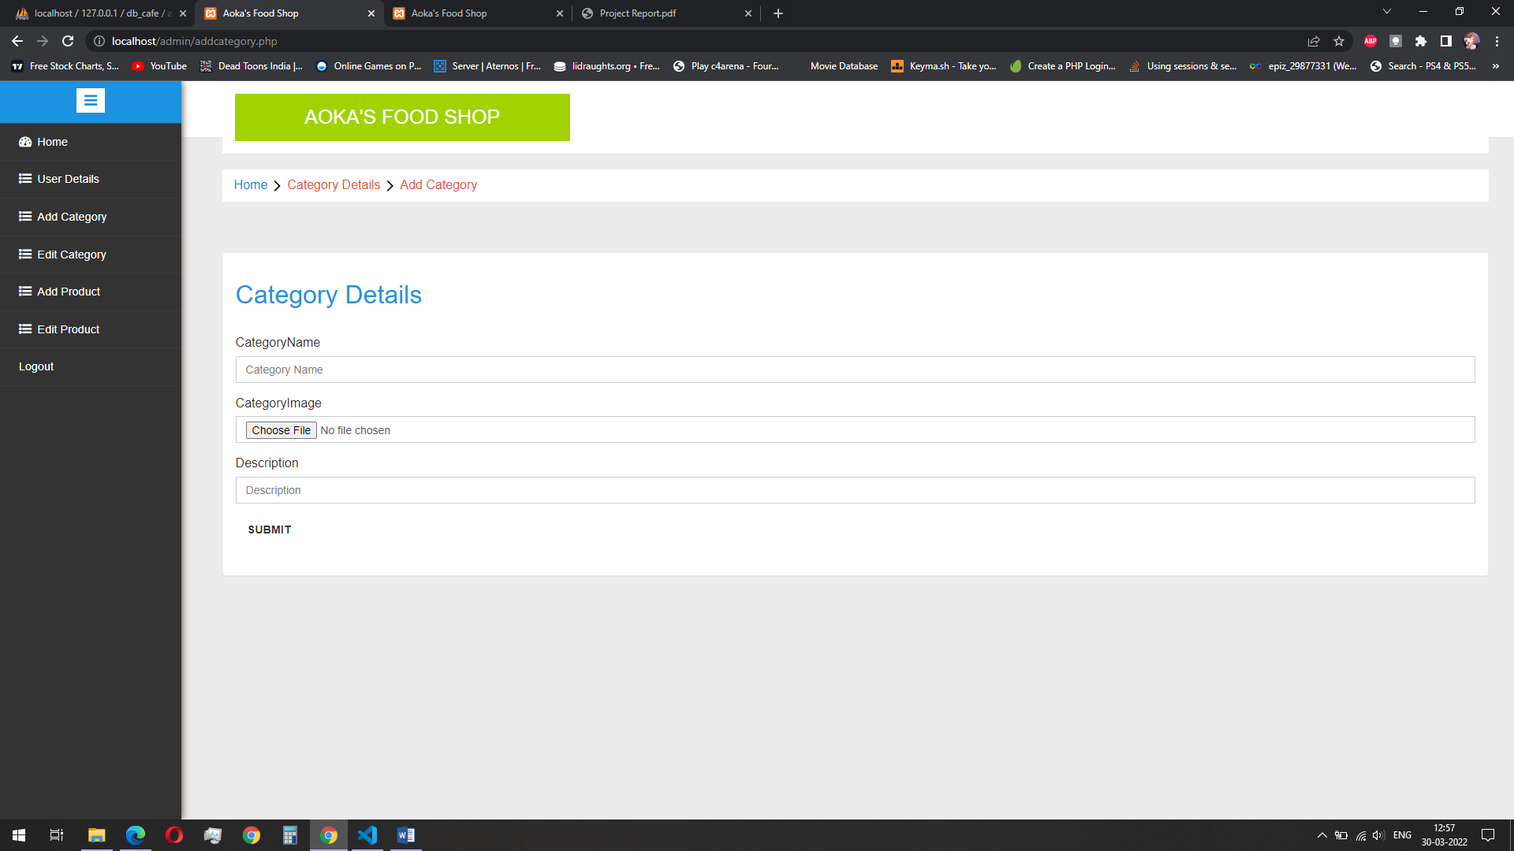
SNAP SHOT : add categories for admin

Slide 38
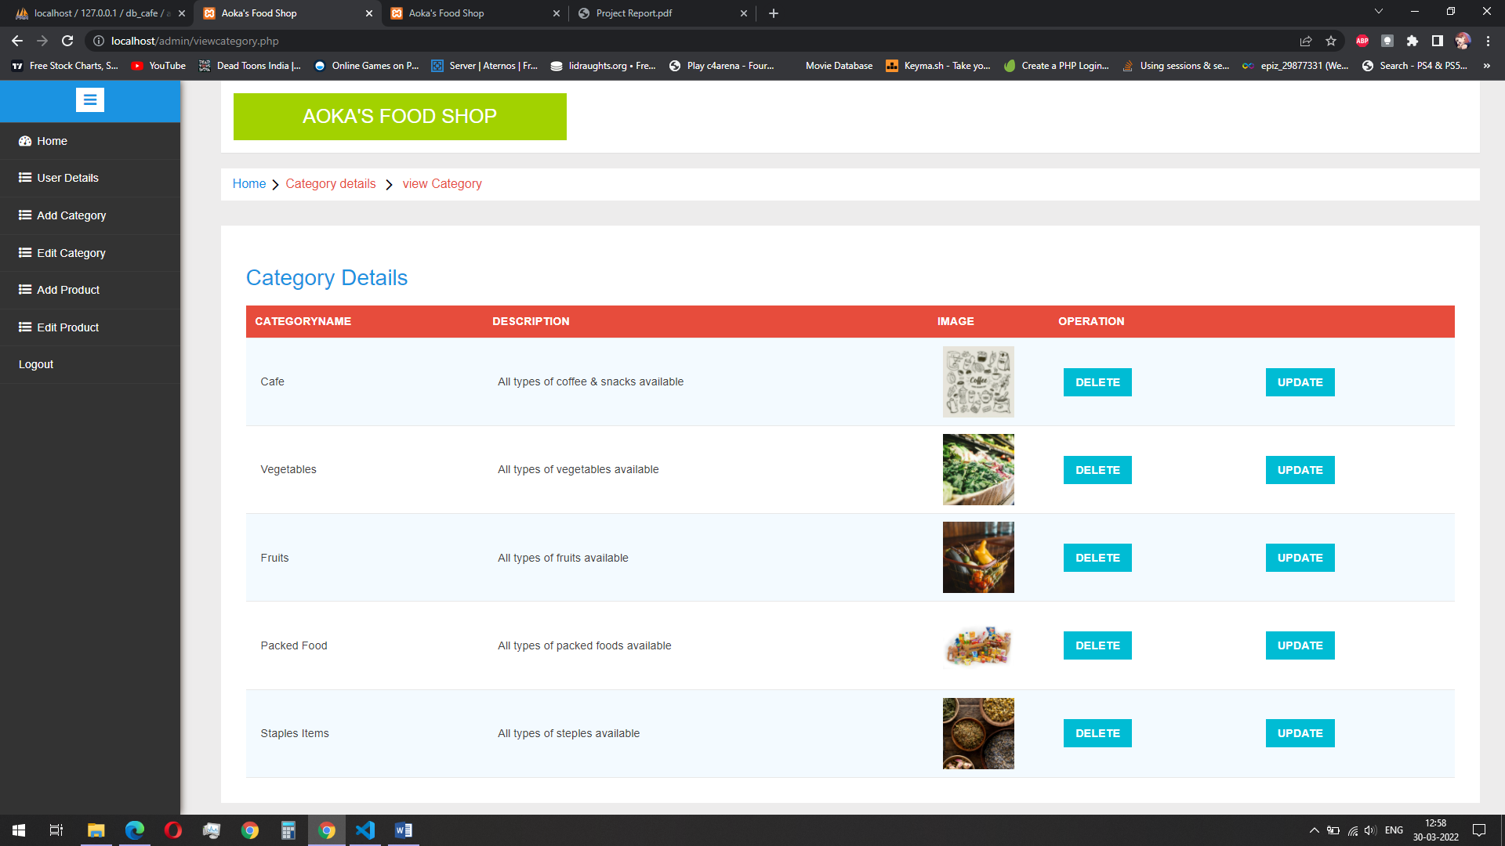
SNAP SHOT : edit categories for admin

Slide 39
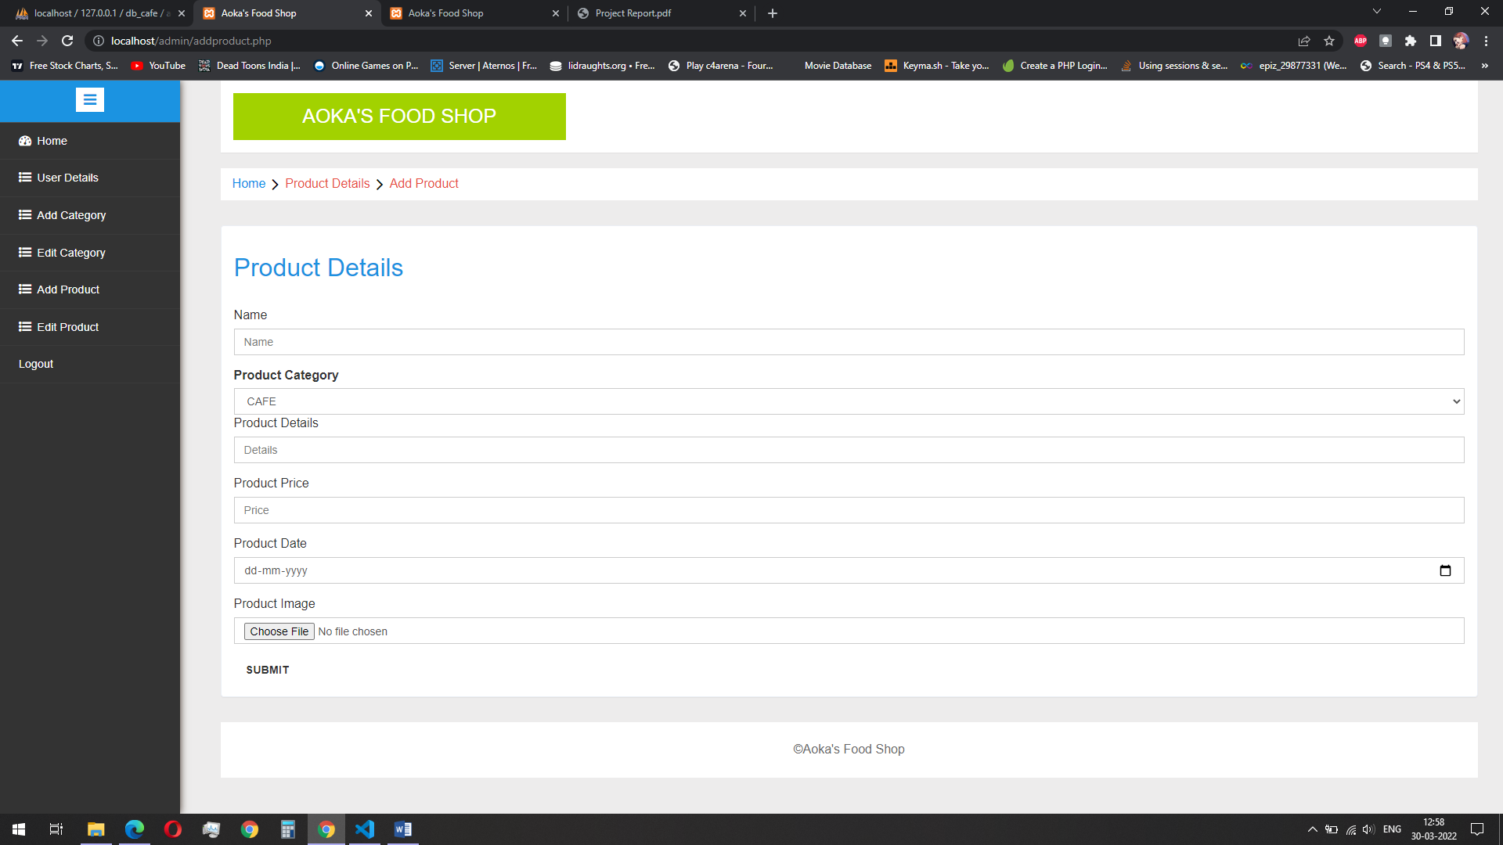
SNAP SHOT : edit categories for admin

Slide 40
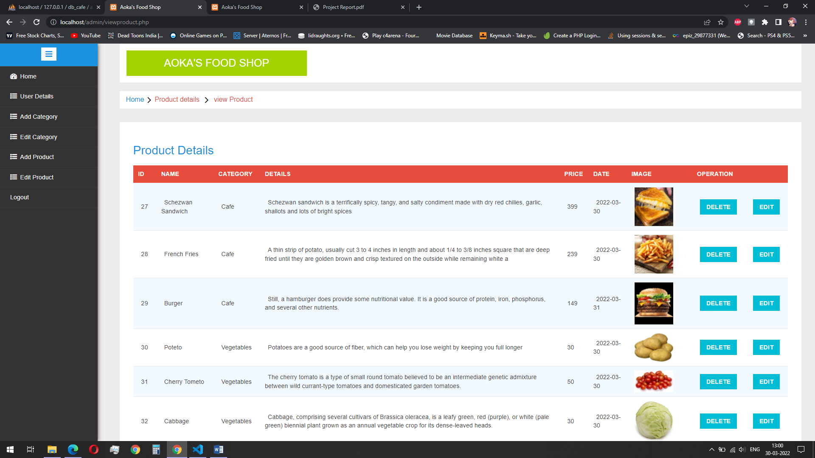
SNAP SHOT : edit categories for admin

Slide 41
CONCLUTION
From the inception of the Internet and e-commerce, the possibilities have become endless for both businesses and consumers. Creating more opportunities for profit and advancements for businesses, while creating more options for consumers.
However, just like anything else, e-commerce has its disadvantages including consumer uncertainties, but nothing that cannot be resolved or avoided by good decision-making and business practices.
By creating this application, we create such opportunities for Aokas Food Shop and through this application the customers can buy groceries, food, drinks very easily without any hassle.

Slide 42
FUTURE WORK
We will optimize the application more and more as time passes so its performance is best.
There will be an option for online payment.

Slide 43
BIBLIOGRAPHY
Books
The Complete Reference-Seventh Edition, Herbert Schildt, Tata McGraw Hill Publications
Programming with Java, E Balagurusamy, Tata McGraw Hill Publications
The Complete Reference, Steven Holzner, McGraw-Hill Osborne ISBN-13: 978- 0071508544
Head First PHP & MySQL, Lynn Beighley, Michael Morrison, O'reilly Media
Websites
https://www.amazon.in/
https://www.bigbasket.com/
https://www.swiggy.com/

Slide 44
Thank you for listening, we hope you liked it.

